Slide 1
Hasan Al-Madfai
Applying for the role of Director, AI Lab, Assurance, London
September 2024

Slide 2
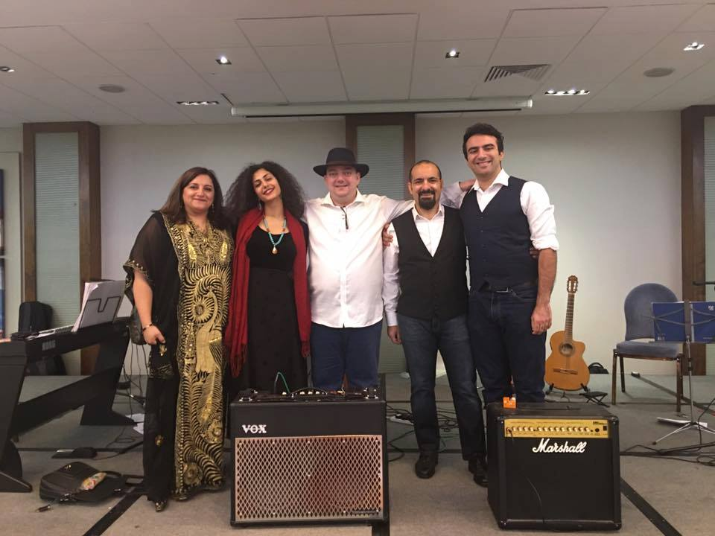
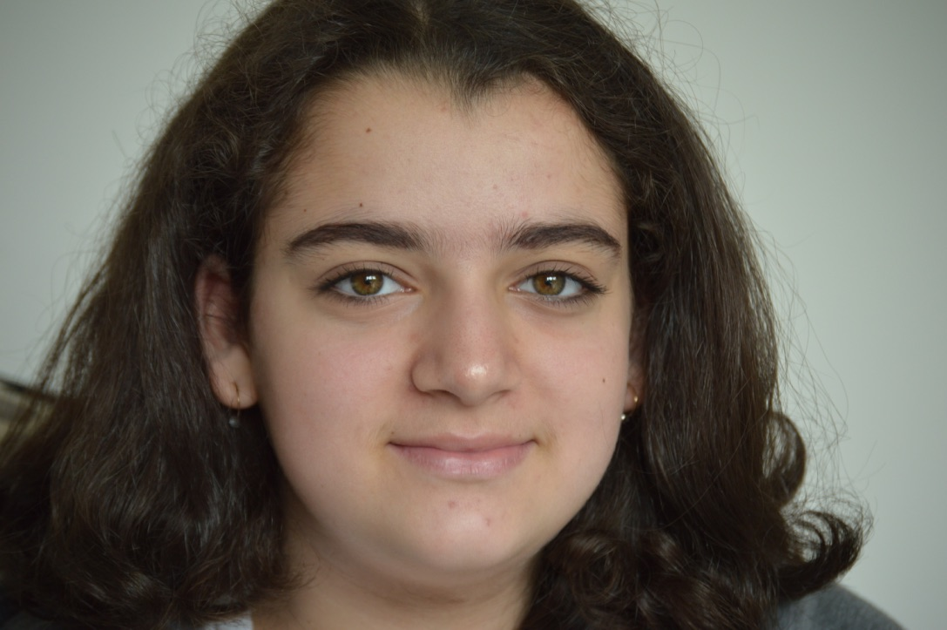







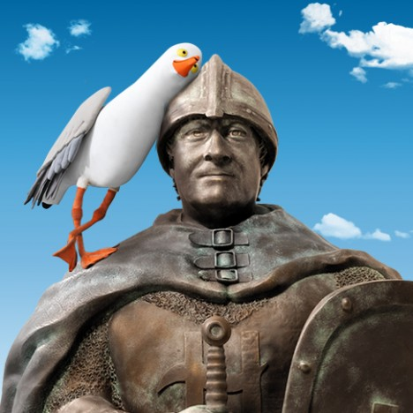









Hasan Al-Madfai
Who am I
What I have done
In the next 3 years….
£
Image source: www.unsplach.com, Open AI ChatGPT generated

Slide 3
Questions:
Reflections on team ambition and purpose following our first conversation
Motivation for moving from current role and for Deloitte v’s other any options on table
Approach to building and leading teams
Views on approach to market activation for AI assurance including relevant market relationships and c-suite/board exposure/experience
Views on evolution of technical approach to AI assurance
Experience of winning work in the market
Experience of/approach to thought leadership and “eminence”
Experience of/approach to working in a matrix/colleague stakeholder management in a large enterprise

Slide 4
Reflections on team ambition and purpose following our first conversation
With wider adoption and increased public awareness, structured AI Assurance is vital for the UK to remain a ‘global superpower in AI’.
Corporate risk:
Direct / C liability
Freedom to innovate
B2C and B2B Trust
Regulatory considerations:
Early stages
Need for standards
Certification challenges
Proposition Opportunity
Timing is right
Influence development / regulators
Become ‘the’ standard
Business Opportunity
Substantial £££££££
Recurring / ongoing
Franchise / outsource tools

Slide 5
Motivation for moving from current role and for Deloitte vs any other options on table

Slide 6
Approach to building and leading teams
Identify end-state / target team structure:
What activities should the team be supporting (pre-sales, R&D, development …)?
Vertical specialisation - how strong is the golden thread across verticals?
What other support would the business processes need / who?
RACI matrices for pertinent business processes
Create the right roles and recruit the right people …
Agree objectives and targets
Drive positive team culture for the team to thrive and grow …
Have fun!

Slide 7
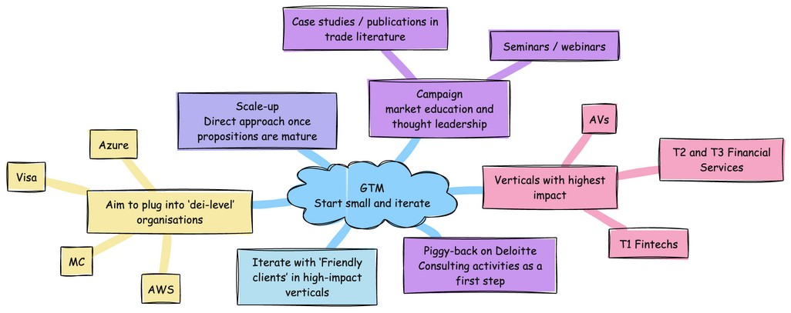
Market activation – a mind map

Slide 8
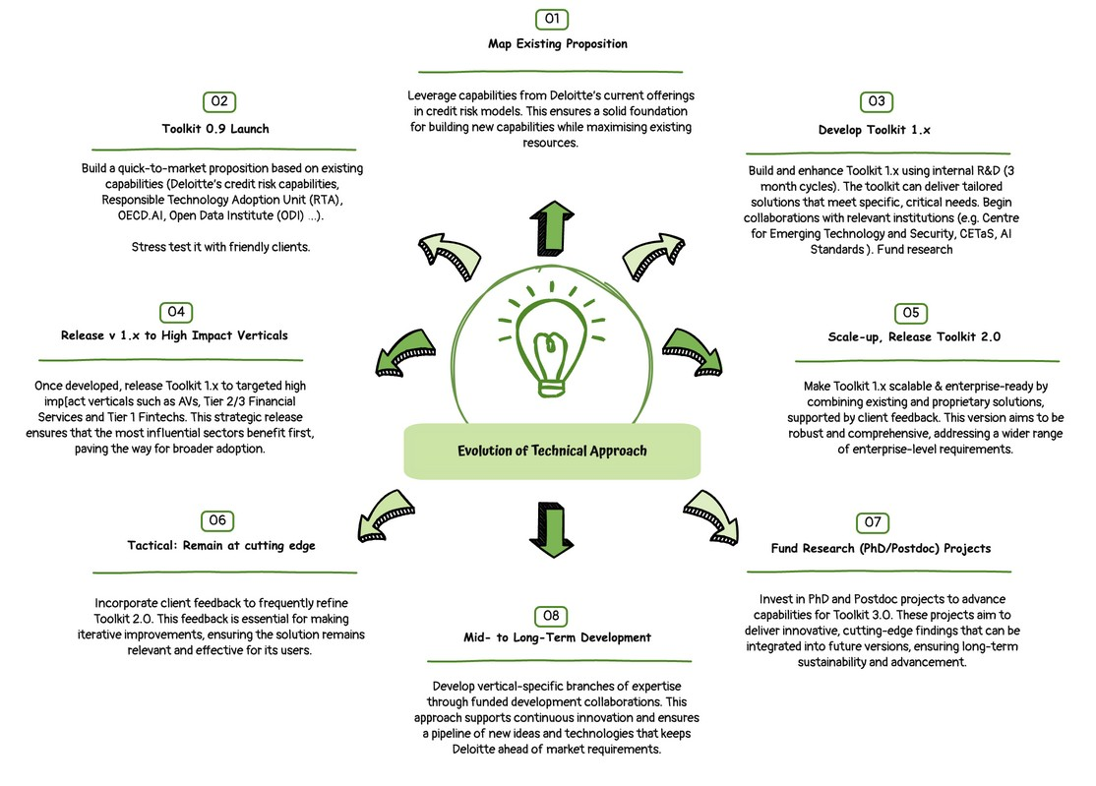

Slide 9
Experience of winning work in the market
Strategic Proposition Development experience
Visa Authentication and Risk Product experience
Visa Consulting Client Win experiences

Slide 10
Experience of/approach to thought leadership and “eminence”
Hasan:
Is a regular conference speaker
Actively publishes research in the area in peer-reviewed journals / conferences†
Is research active through supervision of MSc / PhD work.
Winner of MAS Veritas global AI fairness challenge
Approach
Continue all activities above (All AI Lab Team members) …
Contribute to Deloitte AI Blog – worth thinking of a regular newsletter
Regular LinkedIn posts
Have standing agenda item in Deloitte events / run specific events to showcase development
Plug into C-level networking events (the Wine Club, Chemistry Club, …)
Arrange high exposure interviews / expert input (e.g. news channels, documentaries …)
† Patent: System and Method for Adjusting a Model https://patents.justia.com/inventor/hasan-al-madfai
Paper: Tracking Machine Learning Bias Creep https://oro.open.ac.uk/88769/

Slide 11
Experience of/approach to working in a matrix/colleague stakeholder management in a large enterprise

Slide 12
Thoughts on Timeline
Possible timeline based on pre-employment information
Foundations Built
Q4 /24
Develop academic-level knowledge of AI regulations and liability ecosystem
Understand transferable capabilities within Deloitte’s ecosystem
Start marketing efforts – identify friendly clients
First Clients & Toolkit V0.9 delivered
H1 / 25
On-board people and resources for Ph I ♦︎ Kickstart R&D into next phase
Develop Client value proposition ♦︎ Onboard ‘friendly’ Clients
Release Toolkit 0.9 ♦︎ Vertical evaluation
More Clients and Toolkit v1 delivered
H2 / 25
Release Toolkit 1.x
Scale up for target verticals ♦︎ Begin strategic partnership negotiations
Start people recruitment and resource development for Ph II
Enterprise-ready tools, double number of Clients
H1 / 26
Release Enterprise-ready Toolkit 2.0
Activate flywheel; Tailor propositions to more verticals ♦︎ Extend Client proposition
Test integration with strategic partners

Slide 13
Approach to market activation for AI assurance Relevant market relationships and c-suite/board exposure/experience
GTM – Start small and iterate
Piggy-back on Deloitte Consulting activities as a first step
Verticals with highest impact (AVs, T2 and T3 Financial Services, T1 Fintechs …).
Aim to plug into ‘dei-level’ organisations (Visa, MC, Azure, AWS, …)
Iterate with ‘Friendly clients’ in high-impact verticals
Scale-up, direct approach once propositions are mature.
Campaign – market education and thought leadership
Seminars / webinars
Case studies / publications in trade literature

Slide 14
Views on evolution of technical approach to AI assurance
Map across, where applicable, Deloitte’s existing proposition for credit risk models :
Controls, processes and Client-facing artefacts
Identify and fill in any gaps
Build quick-to-market capability:
Toolkit 0.9 – high impact verticals - based on existing capabilities (Deloitte’s credit risk capabilities, Responsible Technology Adoption Unit (RTA), OECD.AI, Open Data Institute (ODI) …)
Stress test with friendly-clients
Develop: Toolkit 1.x
Internal R&D: 3 month cycles?
Plug into existing efforts e.g. Centre for Emerging Technology and Security (CETaS), AI Standards – fund research
Toolkit 2.0: Enterprise-ready, combination of existing & proprietary supported by client feedback
Toolkit 3.0: Fund PhD/Postdoc projects to further develop capabilities in Mid to long term

Slide 15
